Slide 1
INS Support for IT Data-Lake (Hadoop) Kick-Off
August 2016
INS
Swaroop Trehan
Pat Hockett

Slide 2
INS Big Data Support Approach
Based on Use-Case Data Provided
Reference Material , Attached
Some Data is yet to be determined, those details will likely drive adjustments to the network design, and can impact cost and timing
Engaging an Integrator to Support Design, Planning and Deployment Plan
Details being developed simultaneously
Anticipate Capital and Expense Costs
Two Phase Deployment Approach
Initial Deployment
Minimum Capital spend
Meet immediate requirements
Manage Risk to adjunct Networks
End-State Approach
Have a “Tentative” design, based on anticipated requirements and expectations
May Need to make adjustments based on progress and realities
Budgetary Capital Costs: $2.4 to $3.0 Million
Annual Expense impact expected as well

Slide 3
INS Future Design Considerations
Data Lake Synchronization
Ideally, traffic will not transit the Internal (Shared) Corporate Network
BDT (Bulk Data Transfer) Network, not intended for Data Lake Synchronization
BDT Network is not routed
Designed for backups and large transfers between IT Data Centers (DDC and ODC only today)
Requires New 10G circuits between DDC and ODC Data Lake
Proposing new 10G circuits be installed to allow a routed path between ODC and DDC
IT Test/Dev or other network environments
Do we understand the potential traffic between the Data Lake and the existing IT Test/Dev or other environments

Slide 4
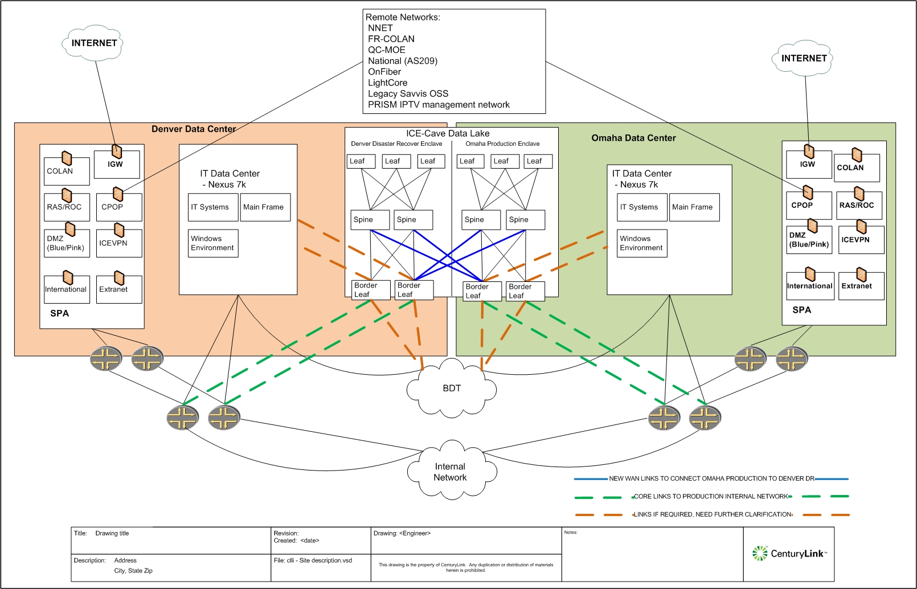
Initial Intended Diagram

Slide 5
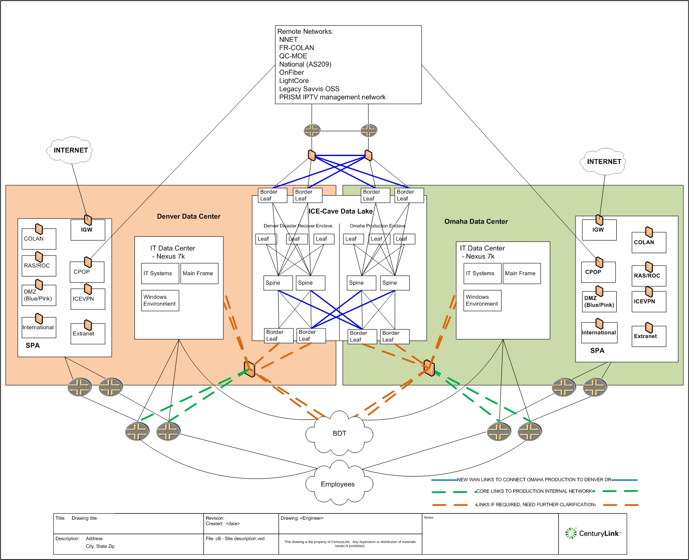
Possible End-State Approach Diagram

